Slide 1

Formatting your
Thesis
or
Dissertation
Deborah A. Phillipp, M.Ed.
Director, Graduate Admissions & Student Services
Notes:
WELCOME to this online presentation of the Graduate School’s workshop on Formatting your Thesis or Dissertation. I’ll be using this time to
-introduce you to some helpful resources
-highlight some of the formatting features you’ll encounter,
-explore the different sections of a typical document, whether it be a thesis or a dissertation, and we’ll get to view some sample pages,
-and lastly, we’ll review the format check process that occurs in OhioLink.
It’s my hope that when this presentation is over, we’ll have removed any fears about formatting and you’ll feel confident about your submission for publication. So, let’s go ahead and get started...

Slide 2


Guidelines
Before anything else, prepare...
Thesis & Dissertation Formatting Guidelines
Digital Accessibility Guidelines
MicroSoft Word Template
Formatting and Writing Tips
Delaying Your Publication
OhioLink Upload
Notes:
A big project like a thesis or dissertation can feel overwhelming. But we know preparation is often the key to success.
YOUR key to success is matching your formatting as closely as you can to the examples provided in the guidelines. The link to the Thesis and Dissertation Formatting guidelines is found on the Graduate school website. The easiest way to the Graduate School website? SIMPLY type Graduate School in the search menu on our campus website...From there... Click CURRENT STUDENTS on the ribbon, then select Your thesis or dissertation from the options on the left side... BOOKMARK THIS PAGE... This is your LIFE LINE. This is the same site I’LL be referring to as I do my format checking, so we’re all playing in the same sandbox.

Slide 3
Why Formatting?
  High standards of presentation
  Standards are applied consistently to all departments and programs
  Precise and complete presentation
  Future publications
Notes:
Before we delve into the fundamentals, Let's consider why formatting is important in the first place…formatting ensures that any thesis or dissertation that bears the university of Akron name shares the same high standards of presentation.
It also ensures that these high standards are applied consistently between all departments and programs across the campus.
Furthermore, think about the accuracy and precision that’s going into the research for your project… you want the presentation of your work to be equally precise and complete.
Lastly, understanding and adhering to the University’s formatting guidelines will only help as you prepare for future research publications after graduation.

Slide 4
Page Format / Margins
Correct margins are:
  Left side 1.5”
    no exceptions
  Right side 1.0”
    no exceptions
  Top 1.0”
    exception: pages that carry major headings, such as preliminary pages and chapter titles, must have a 2.0” top margin
  Bottom 1.0”
    exception: when the last page of a chapter
Figures, tables, and page numbers must fit within the margins
Notes:
Now that we know the purpose behind our formatting, let’s examine what I’ll refer to as some of the fundamentals.
When it comes to margins -- the left margin must be 1 1/2 inches throughout your entire manuscript. ALWAYS. There are no exceptions to this. The remaining margins (top, right, and bottom) should all be one inch. That extra space in the left margin accommodates for the binding of a printed document and prevents any content from disappearing into the binding work. BUT, even if you have no intention of binding your document, the guideline still stands: 1 ½” inch left margin… ALWAYS… no exceptions.
Note bullet point #3 where you see, there IS an exception to the one inch top margin guideline. On any page that introduces a major section (like a new chapter, or a section such as References), the top margin should be 2 inches. This exception only applies to the first page of these major sections...for the remaining pages in the section your top margin returns to 1 inch.
You must also make sure that any figures, tables, images, and even page numbers fit within the required margins.
Setting up the proper margin measurements ensures a strong start to your document.
Any tables or figures must fit within your margins as well

Slide 5
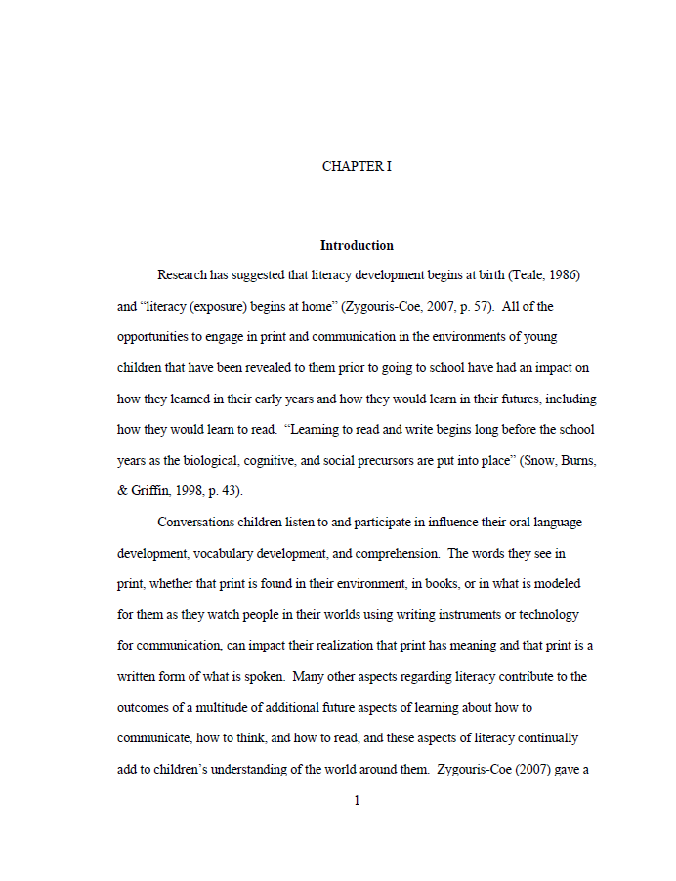
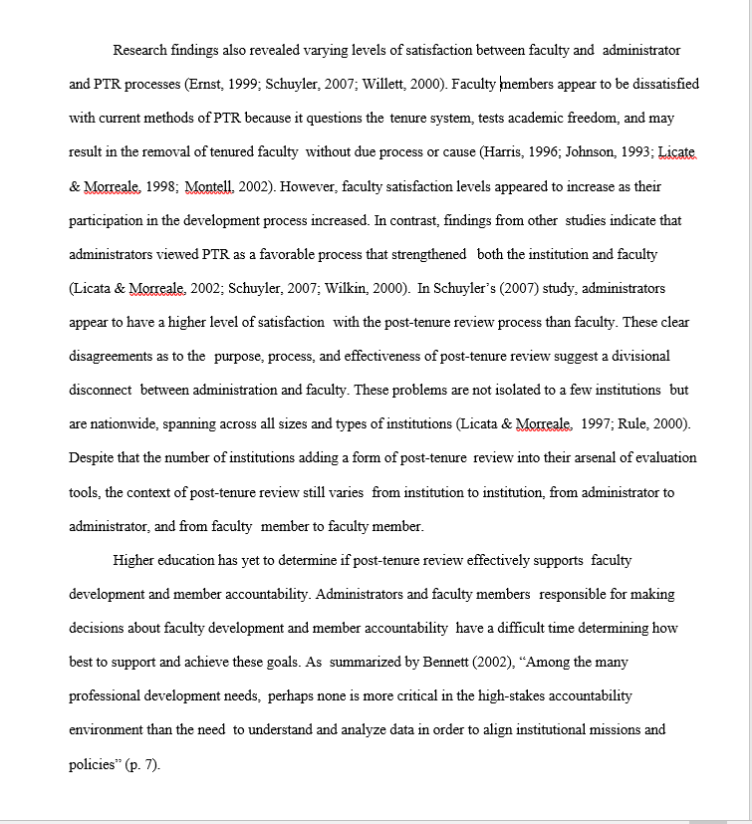
2” top margin
1.5” left margin
1” right margin
Incorrect
Notes:
The page on the left side of the screen, is an example of a correctly formatted page. Being the first page of a chapter, or...the first page of a major section – the top margin is 2”. Remaining pages in this chapter would have a 1” top margin. The left margin is at 1.5”, and the right and bottom margins are both 1”. Note the page number is correctly positioned...sitting just above the 1” bottom margin, and centered.
The page on the right does not follow the guidelines. The margins look to only be about ½” and there is no page number.

Slide 6
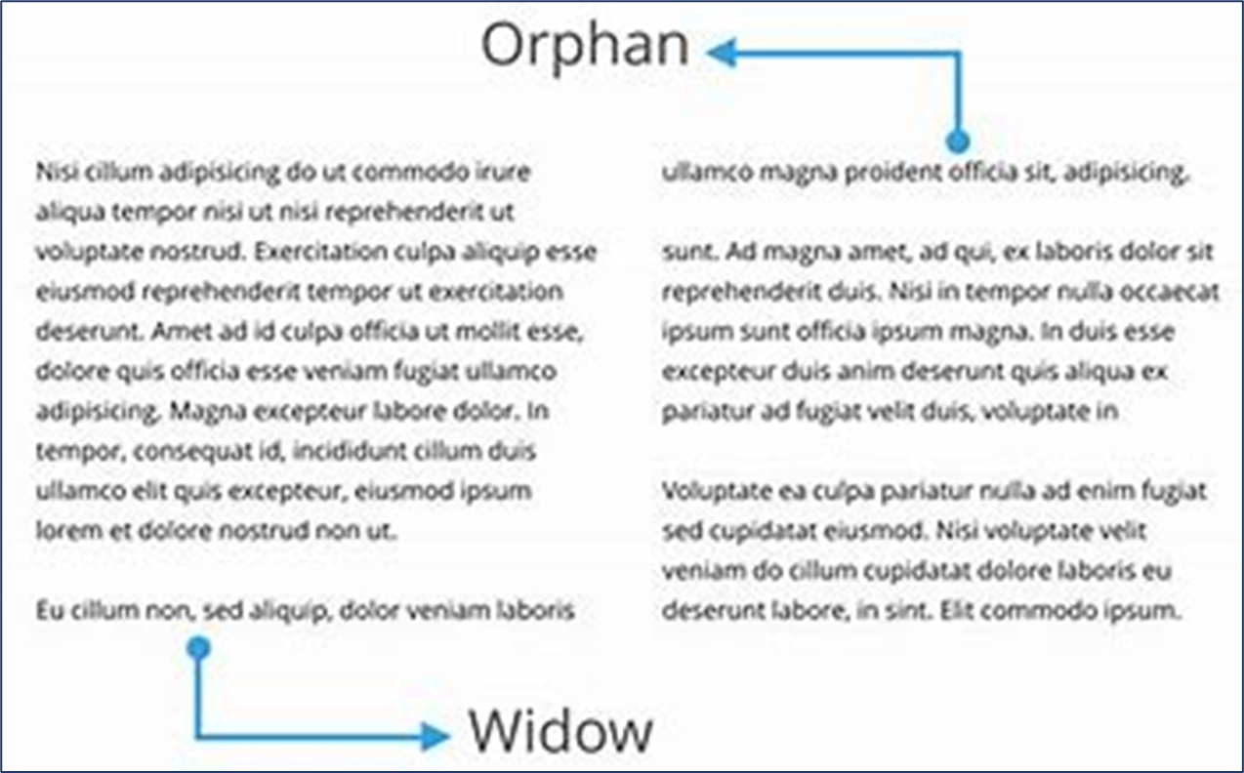
Widow/Orphan Protection
Pages should be spaced so that no page ends or begins with a single line of text.
At least two lines of a paragraph must appear together at the top & bottom of every page
Notes:
Let’s talk about Widow/Orphan protection. Widow/orphan is a term commonly used in the publishing industry describing a spacing issue that can occur within a document. It’s when a single line of text gets separated from the rest of the paragraph and is left ALONE at either the top or the bottom of the page. This is something to avoid in your manuscript, AND in Microsoft Word, there is a widow/orphan setting you can use for help.
Controlling Widow/orphan improves the layout by balancing the content flowing from page to page, making it easier on the eyes of your reader. You’ll want to space your content So that no page ends or begins with just a single line of text. At least two lines of a paragraph must appear together at the top and bottom of every page.

Slide 7
Spacing
Text material is double spaced throughout.
Single spacing may be used in:
  figure captions
  table titles
  long quotations (properly indented)
  notes
  reference list or Table of Contents (double-space between individual entries)
Do not insert extra blank lines or spacing to separate text; avoid excessive white/blank space
Notes:
The guidelines specify double-spacing text throughout your entire document, but there are times when single-spacing is acceptable...
In your figure captions or descriptive table titles, or if you’re embedding a lengthy quote in your text, or including notes at the bottom of a page.
In any lists found in your document, it is appropriate to single-space any entries that have more than one line of text... However when doing so, you should maintain the double-spacing between each individual entry)
There should never be more than 2 blank lines of blank space anywhere in your document. Where I often see excessive blank space is when figures or tables are involved. I think many students believe that the table, or figure, or image has to be the only thing displaying on the page...and this is not the case. You should continue with content or text on that same page if appropriate, keeping widow/orphan in mind. Obviously, if the next page is the start of a new chapter, you would not include that on the same page, given that it’s the start of a new section. In short, keep your spacing consistent.

Slide 8
Typeface, Justification, Centering & Paragraphing
Fonts
  MUST be consistent throughout the manuscript
  Font size must the same size throughout (12 point preferred)
  Most fonts are acceptable, however San Serif is preferred
  Unusual or scripted fonts are not acceptable
  Do not use bold font for major titles or figure/table titles
The left margin must be justified
Right margins may be justified if the department/college approves
  Note: full-justified margins may result in unsightly gaps/spaces between words that are not acceptable.
Indent the first line of every paragraph consistently (5 spaces preferred)
Notes:
Next up, Typeface, Justification, Centering and Paragraphing. It’s important to be consistent throughout the entire document. A 12 point fontsize is preferred however you can go as low a 10pt. -- 11 point is also acceptable... But the maximum size allowable is 12 pt. Even chapter titles and headers of major sections should be the same size as the text in the main body. Everything should be the same size.
Most font styles are acceptable. A sans serif font is commonly used in e-publishing, conveying a modern or simplistic look (some examples of sans serif font would be Arial, Helvetica, or Tahoma...the font used in this presentation is a type of Sans Serif). But I see many manuscripts submitted using serif fonts, like Times New Roman, often used for printed material, and also acceptable.
Do not use bold typeface for major titles or within captions or titles of your figures and tables. I understand the desire to emphasize a point, or make it stand out, but bold typeface DOES go against the guidelines and serves no purpose in the thesis or dissertation.
I’ve mentioned the 1.5” left margin a time or two already… it’s crucial that you keep that margin justified and that no content spills into that section between the margin and the page edge.
Occasionally I will see a document submitted with full justified margins. This is where the text lines up with the right side one-inch margin. While acceptable, this format can cause issues as it sometimes puts extra spacing between the words of the sentence. This is not acceptable, so you will have to use extra caution when proofreading your document to ensure this hasn’t happened. Fortunately, Microsoft Word has a setting you can use to help with this. The setting is called “Hyphenation” and when turned, it will prevent those unsightly gaps in your text.
Lastly, remember that the first line of every paragraph requires indentation. When introducing a new thought or concept to your reader, typically a new paragraph is started, and the first sentence of that new paragraph should be indented. A five space indent is preferred, but not required... I’m not going to count the spaces – just keep it consistent throughout the document.

Slide 9

Page Numbering
Preliminary pages, or front matter, are numbered using lowercase Roman numerals (i, ii, iii)
  Copyright page (optional)
  Title page
    Do not put a page number on the title page.
  The signature page
    Number this page using a lowercase Roman numeral ii.
Text pages (beginning with CHAPTER I) are in Arabic numerals (1, 2, 3, etc.)
  Beginning with page 1 of CHAPTER I, all following pages are numbered sequentially through the end of the manuscript.
Notes:
In the preliminary pages section (also known as front matter), we use lowercase Roman numerals for page numbers. Examples of content found in the front matter section include copyright page, the title page, signature page, the abstract, dedication, and acknowledgement pages, the table of contents, and what I call LIST PAGES that outline things like figures, or tables, or images that appear in your work.
Here’s where it can get tricky... If you use a copyright page, that would be your first page. Next comes the title page, followed by your signature page. The signature page is the first time we see a page number displayed... and that page number will be a lowercase Roman numeral 2... Centered, and sitting just above the 1” bottom page margin. You’ll continue using the lowercase Roman numeral to number the remaining pages of the front matter section.
With chapter one, page numbering SWITCHES to Arabic numerals. Page one of chapter one is assigned page number 1... and subsequent pages are numbered sequentially all the way through to the end of the manuscript...including your references and appendices pages. Page embellishments are not permitted this would include like page 1A1B etc, And all pages have the page number placed at the bottom of the page centered under the text at the one inch bottom margin.

Slide 10
Page Numbering (con’t)
Page number embellishments are not permitted (1a, 1b, etc.)
All pages have the page number placed at the bottom of the page, centered under the text at the 1 inch bottom margin.
Copyright page (optional page)
  is placed as the very first page (before the title page)
  is neither counted nor numbered
Notes:
In the United States today, copyright protection automatically covers all new copyrightable works, including your dissertation. The moment a copyrightable work is fixed in a tangible medium of expression (e.g., written on a piece of paper or on your hard drive), it is subject to copyright.
In the past, authors had to comply with certain formalities in order to obtain copyright protection. These formalities included registering the work with the US Copyright Office and placing a copyright notice on the work. Copyright law no longer requires that authors comply with these formalities merely to obtain copyright protection.

Slide 11
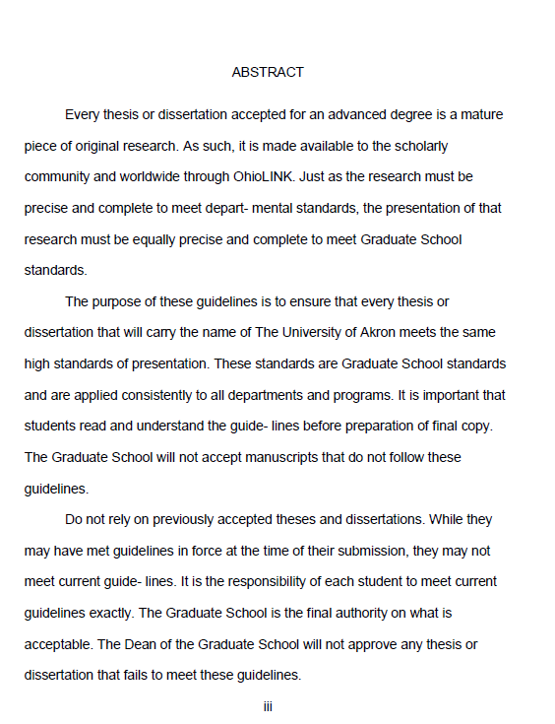
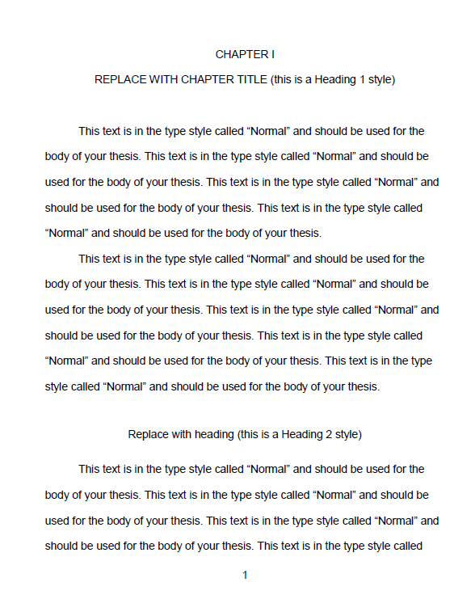

Notes:
Here are example of correct page numbering (please note that the margins not to scale)

Slide 12
Manuscript Organization
Copyright Notice (optional)
Title Page (not numbered)
Signature Page (page ii)
Abstract
Dedication (optional)
Acknowledgements (optional)
Table of Contents
List of Tables (as needed)
List of Figures (as needed)
List of Illustrations (as needed)
List of Schemes (as needed)
Chapters (begin Arabic page numbering, I, II, III, IV, V)
Bibliography
Appendices
Notes:
The content of your thesis or dissertation should follow the general organization shown here. Note the copyright page is optional. By virtue of uploading your document to OhioLink, your work is copyrighted. Not including a copyright page won’t hurt you, and providing one won’t result in extra protection.
In this list, the preliminary page section ranges from the title page to what I call the list pages. Your work may include all 4 of the List Pages showing here... Or, it’s possible that you won’t have any list pages at all.
The Body of your Manuscript consists of your chapters... And there’s our reminder that when the chapters begin, the switch to Arabic page numbering is made. But... Your chapter titles will be labeled using uppercase Roman numerals. If you’re submitting a thesis, you might not have five chapters... But, i in general:
chapter one is your introduction chapter 2 is the literature review chapter 3 discusses your research methods chapter 4 includes your research results and discussion and chapter 5 consist of your conclusions and future work.
Your bibliography or reference sections will come immediately after your last chapter, and if you use an appendix that section will follow.

Slide 13
Title Page
All text on this page is centered
Double space the entire page
The top margin is two-inches (2”)
Title
  Must be in all capital letters
  Must be centered immediately below the two-inch top margin
Graduation date
  Must be month, year of graduation (May, August or December only)
The title page does not get numbered
  (it gets counted, but do not display a page number)
Notes:
On the Title page
-all text on this page is centered and double spaced
-This page requires a 2 inch top margin. Your title must be in all capital letters and it must be centered just below that 2 inch top margin.
-Your graduation date on this page this must be the month and year of your graduation, so May August or December are your only options
-Remember the title page is counted as Page 1, or lowercase Roman numeral 1… But that’s just something to keep in mind because it actually won’t be displayed.

Slide 14
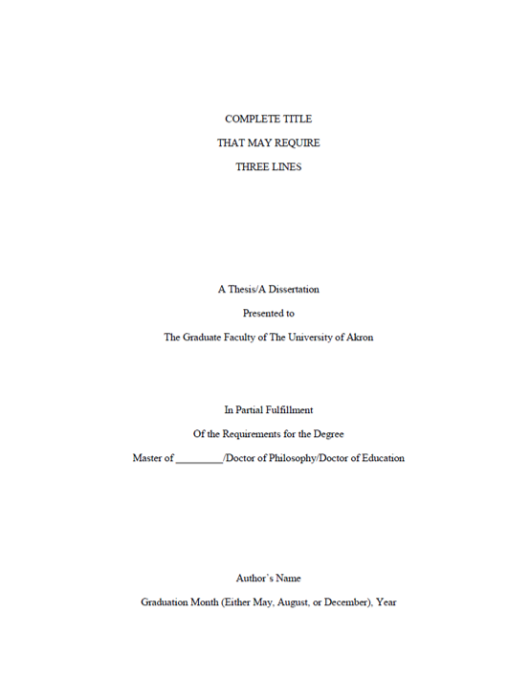
Title Page
Notes:
So here's an example of a properly formatted title page notice the
two inch top margin
left margin at 1 1/2 inches
right margin is 1 inch
the bottom margin is at 1 inch
the title centered in all caps again at that 2 inch top margin notice the graduation month at the bottom one inch margin

Slide 15
Signature Page
Title
  All capital letters
  Centered between the left & right margins with a two-inch top margin
  Double spaced if two or more lines
Author’s name and document type
The names of those signing are typed a single space below their titles
Use “Dr.”, “Mr.”, “Mrs.”, “Ms.”, before all names
Signature page is the first page to be numbered,
using a lowercase Roman numeral ii
Notes:
Your signature page comes next
With this page, you’ll start out like you did with the previous Title Page… the title in all capital letters, centered immediately below that 2 inch top margin
the title can be double spaced if it consists of two or more lines but Please note that the maximum is three lines for a title
then comes the author’s name (that’s you). This is going to be case sensitive so that means it's not in all caps
The titles and names of those signing are also case sensitive and are placed single-space below their respective signature lines. Please use the appropriate titles before all names, such as Doctor, Mr., Ms., etc.
Remember that this page is the first time we’ll see a page number displayed… and that page number will be lowercase Roman numeral 2.

Slide 16
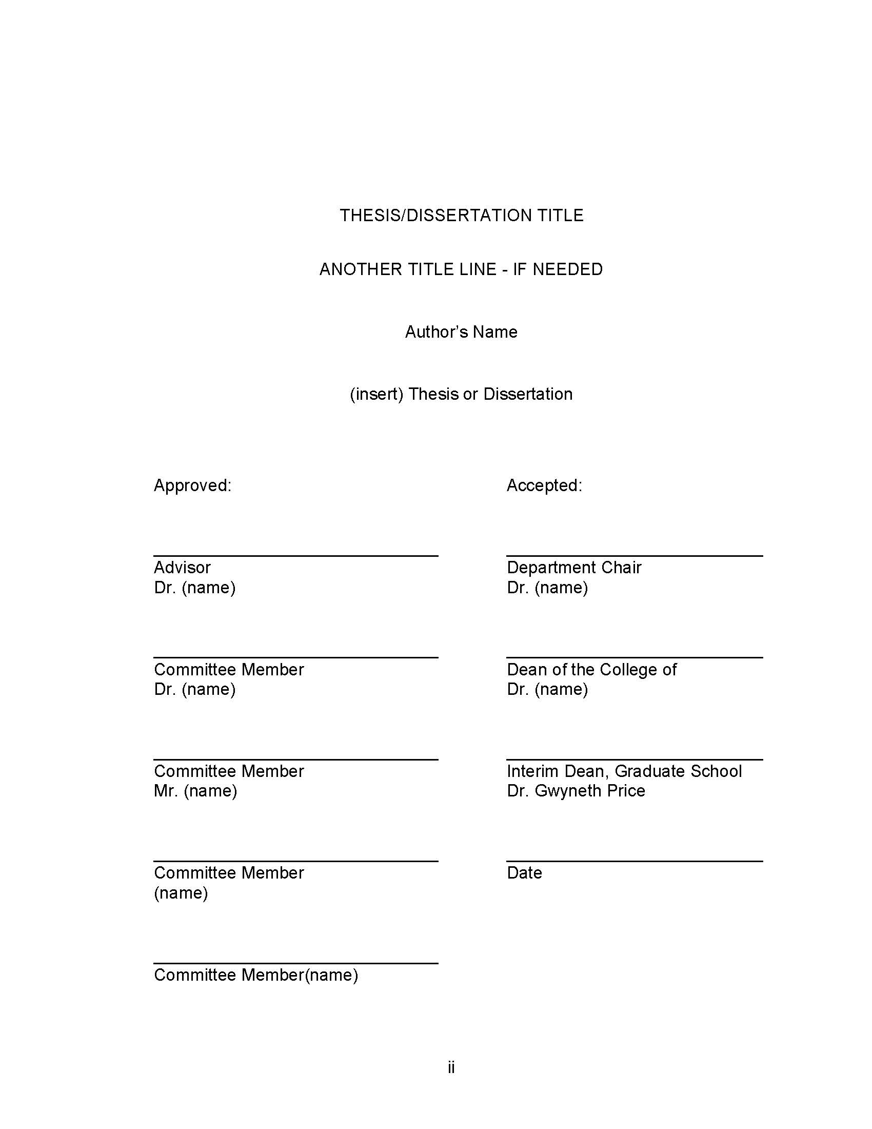
Signature Page
College Deans & College Names
Dean, Buchtel College of Arts & Sciences Dr. Mitchell S. McKinney
Dean, College of Engineering & Polymer Science
Dr. Craig Menzemer
Dean, College of Health and Human Sciences
Dr. Daniel Friesner
Dean of the College of Business
R.J. Nemer, J.D.
Interim Dean, Graduate School
Dr. Gwyneth Price
Notes:
On this example you can see how the page is formatted notice how the names of your committee members and others are presented the approvers are on the left side and acceptors are listed on the right side, listing the respective title under the name.
this example shows a five person committee member you can adjust the list to fit the committee structure by adding or removing members from the approved site
Again… this is where we’ll see the first appearance of a page number. But here’s one thing we WON’T see on this page…. The actual signatures. When this page gets submitted to OhioLink, it will be without signatures.

Slide 17
Table of Contents (TOC)
All entries in the Table of Contents must match exactly as they appear in the text including: wording, numbering, punctuation, capitalization and spelling and page number on which they appear
Preliminary pages that occur before the TOC are not included
Preliminary pages that occur after the TOC are included (List of Tables, etc.)
On the row below the last LIST, enter the word “CHAPTER.” This word appears only once in the TOC.
Below the word CHAPTER comes the entry for the first chapter. Chapter titles are typed in all capital letters, preceded with uppercase Roman numerals
  Subheadings are case-specific
Double Space between entries
Single space within an entry if two or more lines of text
Notes:
The table of contents is where I see the majority of formatting issues happen.
All entries on the TOC must match exactly as they appear in the text
Starting with Preliminary pages, or front matter section, anything prior to the Table of Contents should not appear in the table of contents listing… so, if you remember, that’s the title and signature page, the abstract, a dedication, acknowledgements...these are NOT part of the table of contents.
Preliminary pages that appear after the table of contents are included. These are those list pages I spoke of in previous slides, like List of Figures, List of Tables, etc.
After the last list page entry insert a row with the word CHAPTER…all by itself, left-aligned. Below the word CHAPTER comes the entry for the first chapter title, in all capital letters, labeled with an uppercase Roman numeral I.
Any subheadings, however, will use Case Specific entries. Single-spacing is permissible for entries that are two or more lines.

Slide 18
Table of Contents (cont’d)
Indenting should be consistent basis
Use dot leaders ( .... )
If there is only one appendix, label the entry as APPENDIX
If there are multiple appendices, label entry as APPENDICES
Appendices should be labeled as APPENDIX A, APPENDIX B, etc. including titles in all caps
Notes:
More about the TOC before we look at some samples... When using Indentations for subheading listings, be consistent. Every entry on the table of contents must include dot leaders, which is a series of dots between the text and the corresponding page number
if you only have one appendix, there will be an entry after the Reference entry
if using multiple appendices, enter the word APPENDICES after your entry for your References, entering each individual appendix title below...indented.

Slide 19
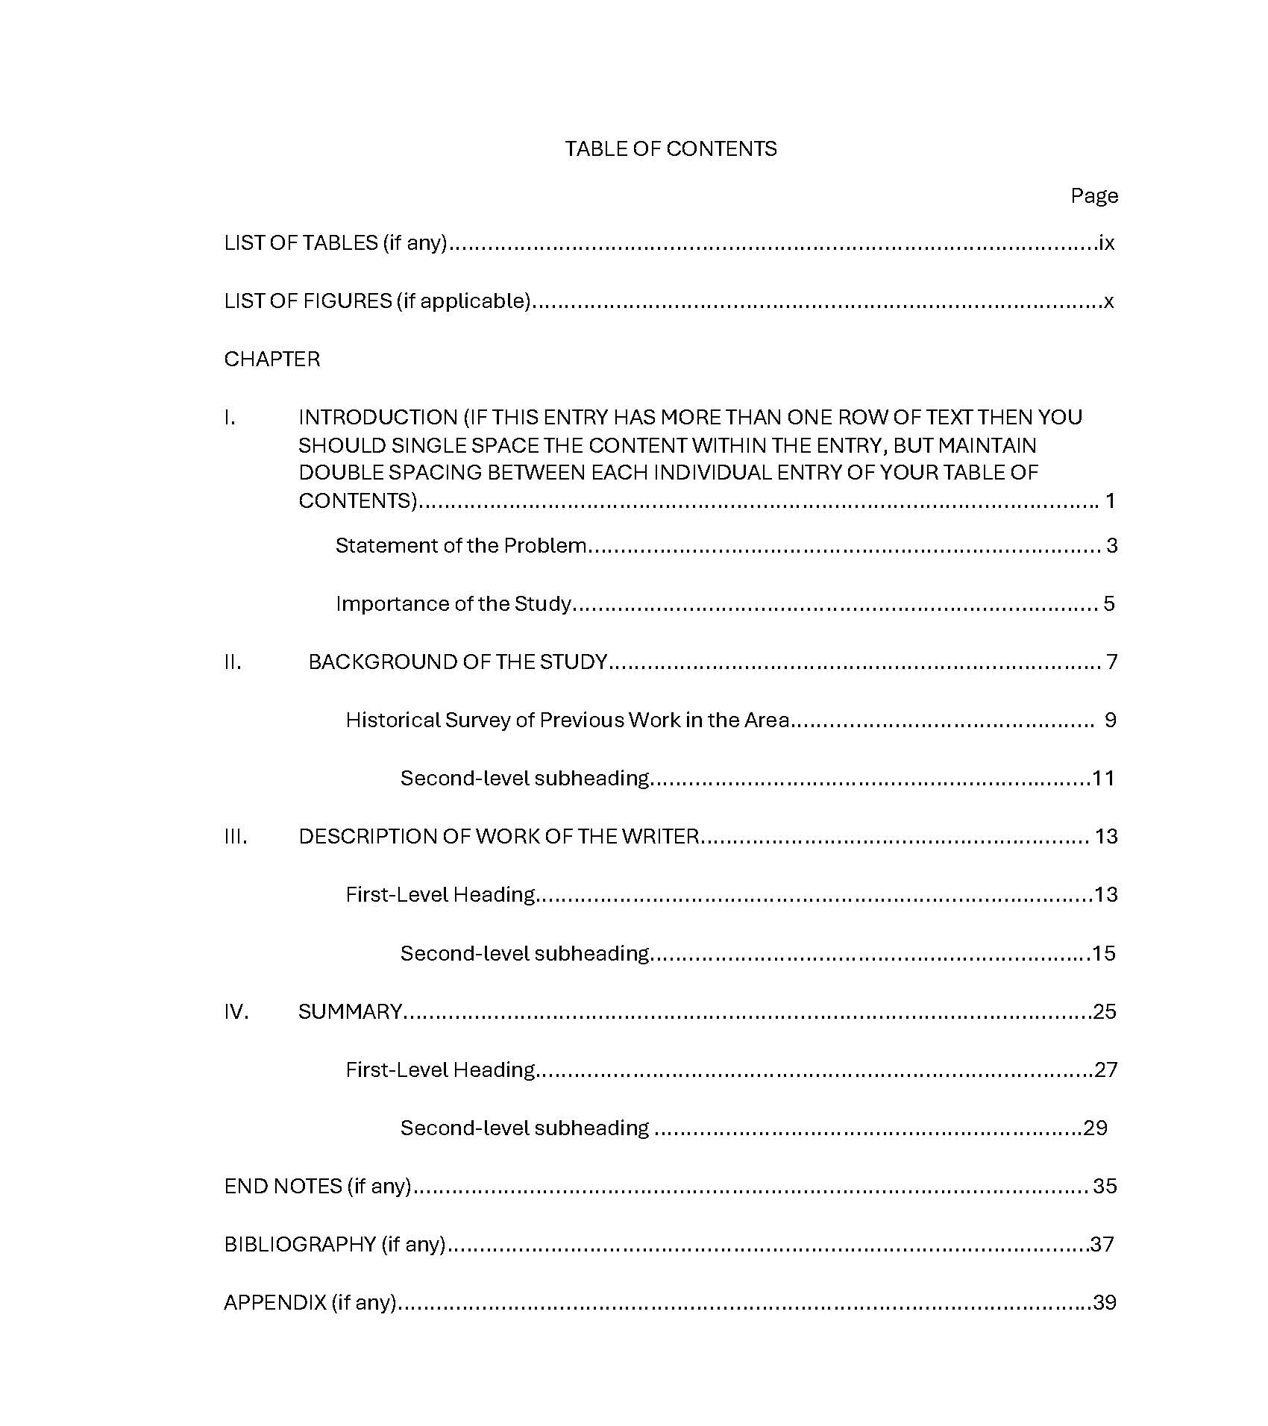
Notes:
Here is an example of a correctly formatted TOC, although notice it’s not to scale, because I couldn’t fit an entire page on one slide. So, we’re pretending this page has a 2” top margin, and 1” bottom margin with a page number.
Now let’s look at the TOC entries:
-Beginning with the title in all capital letters
-Insert the word Page over the column of page #s
-After your entries for the LOT, LOF or any other lists, your next entry is the word CHAPTER – all capital letters and nothing else.
-Below the word CHAPTER comes the entries for all of your chapters: In all capital letters, labeled with the corresponding uppercase Roman numeral...the word CHAPTER does not get repeated with your chapter entries.
-See chapter I is more than one line of text, so the entry is single-spaced...but your maintaining double-spacing everywhere else in the TOC. here.
-The major subheading for chapter 2 contains a sub-level heading, so that entry gets indented further inward.
-Be consistent with your subheading indentations ...notice that when listing multiple levels of subheadings, the spacing of your indentations increase.
-Notice your headings and chapter numbers are justified flush against the 1.5” left margin.
-In this example, the subheadings are not numbered, and that is fine. Also, there is only 1 appendix.
The next page shows another example of how you can format using numbering, which is common in scientific writing.
Either TOC is fine

Slide 20
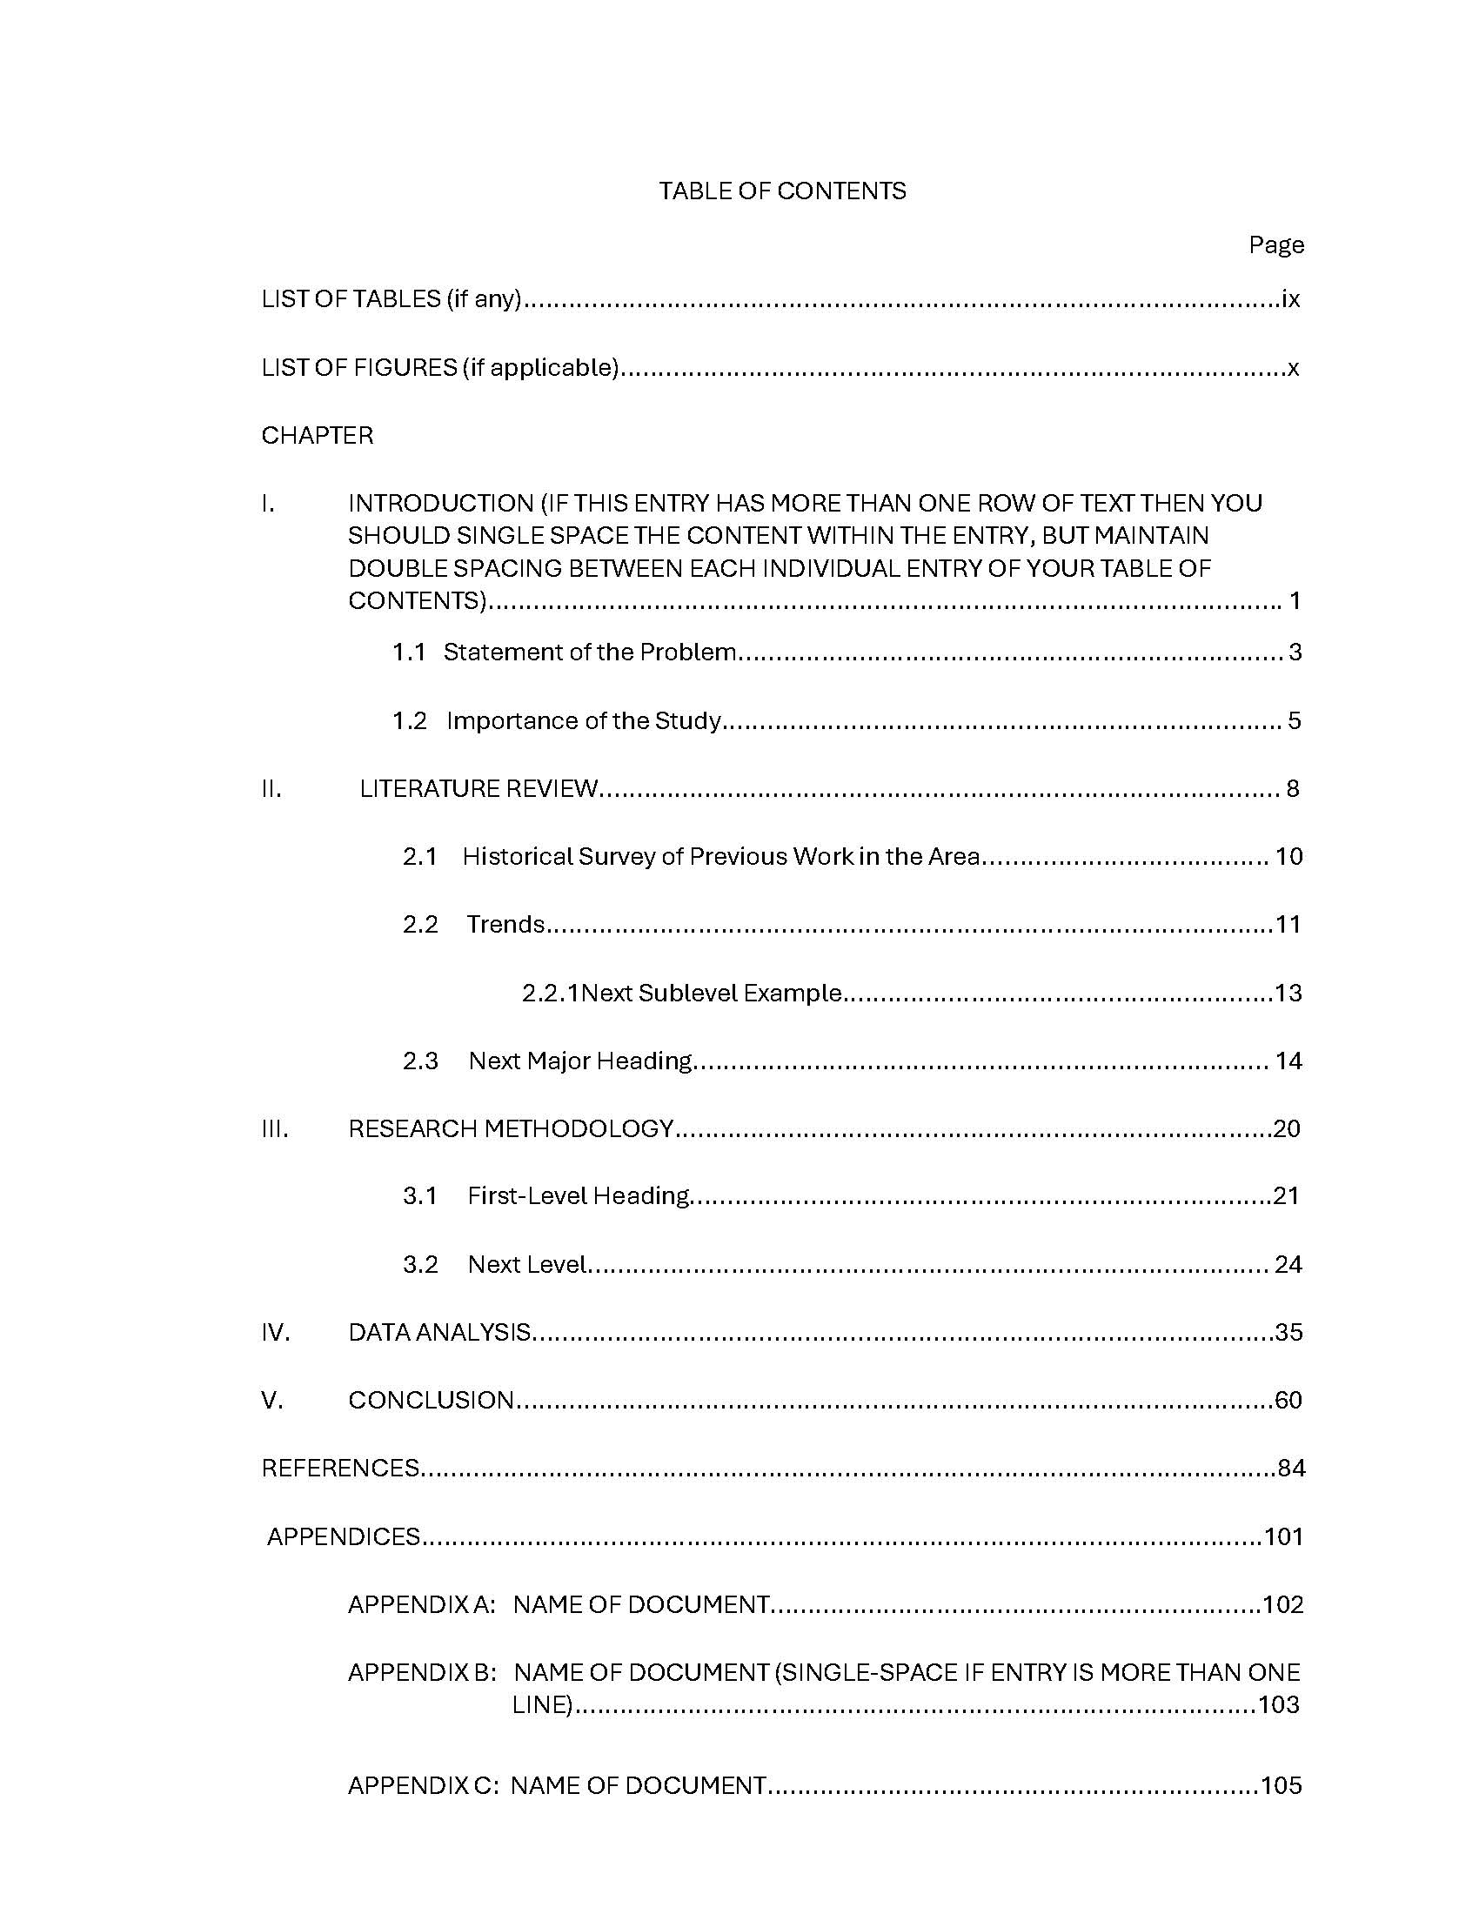
Notes:
(Again, we’re pretending we have a top 2” margin and bottom 1” margin and page number). We’re following the same guidelines discussed on the previous slide – but just a couple of differences to note:
...in this case, our sub-headings are numbered. While your chapters are labeled using Uppercase Roman numerals, sublevel headings will be labeled using Arabic numbers, corresponding with the chapter in which the information is presented.
-The other difference in this example... there is more than one Appendix, so in your TOC, the entry for this section with be the plural for the word......... APPENDICES...this entry is assigned a page number, and the titles for each individual appendix are entered below... Indented, in all capital letters, and labeled beginning with the letter A. Appendix B has more than one line of text so it’s single-spaced... While other entries are double-spaced.
Before we move on to discuss the formatting of your LISTS sections, keep in mind that APPENDICES entry... We’ll come back to it later.

Slide 21
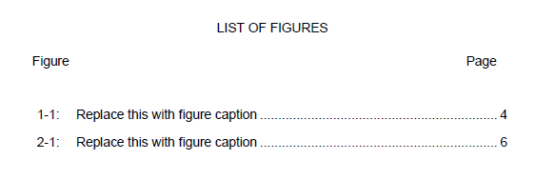
TOC: List of Tables and List of Figures
“Figure,” “Table, ” or the appropriate heading is typed above the number designation column (left).
Type “Page” (right)
Do not type “heading label” before every entry
Notes:
As previously mentioned, your LIST sections are the first entries in the TOC, if being used. Here’s a snippet of what these pages should look like.
-Another start of a major section...so the top margin of the first page of this section is 2”... The title is again centered and in all capital letters. We see the word page inserted over the column of page numbers...and likewise, the word Figure (or Table if appropriate) is inserted over the descriptions, aligned with the left 1.5” margin.
-Below the word Figure begins your entries for each item, labeled using Arabic numbering, flush against the left margin and in the order of appearance throughout the body of the document.
-Another reminder that Individual entries are double-spaced, (single-spacing any entries that have more than one line of text)
-AND… do not type the label heading before every entry… in this example, notice we start with 1.1 not figure 1.1

Slide 22
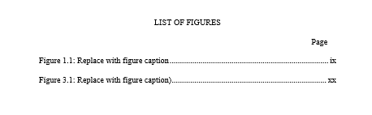

TOC: List of ...
Notes:
All entries on lists of tables list of figures must appear exactly as they appear in their text The only exception is if the description is too long in this case you should only use the full first sentence of the description
For your “List” pages –
DO NOT include the following descriptors – only the number
Figure
Table
Scheme
Illustration

Slide 23
TOC: List of Tables and List of Figures
All entries in List of Tables, List of Figures, etc must match exactly as they appear in the text, including -- wording, numbering, punctuation, capitalization and spelling and page number on which the table/figure appears.
Exception – if the description is too long, you may opt to include only the first full sentence of the description.
Notes:
All entries on lists of tables and list of figures must match exactly as they appear in their text. The only exception would be if you had an extremely lengthy description... In this case, it is acceptable (and highly encouraged) that you only enter the first complete sentence of the description.
Remember, double space between entries…. And if an entry has two or more lines, single-spacing is appropriate for that specific entry.

Slide 24
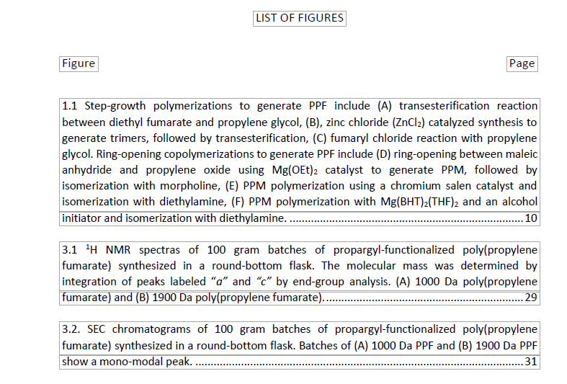
TOC: List of Tables and List of Figures
Notes:
So here's another example of how to properly format those lists of figures or tables etc note this is showing the format only and it's not to scale
Note – this is showing how to format only; not to scale.
This example shows the single space caption of a figures, but double space between each item.

Slide 25
TOC: List of Tables and List of Figures
Do not use combinations of letters and number for your table/figure designations.
    Example: If working in Chapter 4
      Do Use: 4.2, 4.3, 4.4
      Do Not Use: 4A, 4B, 4C
Notes:
So a few more housekeeping notes on your list pages do not use combinations of letters and numbers for your table or figure designations...On this slide, the correct labeling for figures in chapter 4 would be 4.2, 4.3., and 4.4... Not 4A, 4B, 4C

Slide 26
Tables / Figure within the Text
Table titles appear above the table
Figure/Scheme captions are to be placed below the figure/scheme
Do not bold any part of the title/figure text
Each title/caption must be numbered consecutively in Arabic numbers
Landscaped entries are acceptable, but page margins will change if doing so (the 1.5” margin will become the top margin)
Notes:
Some general guidelines to keep in mind for your tables and figures used throughout the text.
Do not Bold any part of the table title or figure caption.
-And align your titles or captions flush against the left edge of the image or table.
-Table titles are placed above the table, and figure captions are placed beneath the figure. The term figure includes all types of graphic illustrations, charts, graphs, photographs, illustration, maps, etc. Tables and figures may be positioned Portrait-style or landscaped…but must fit between the page margins.

Slide 27
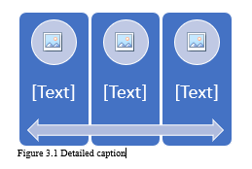
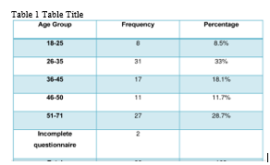
Tables / Figure with the Text
Notes:
So here you can see the placement of the titles for tables and figure captions. On the right we see a table... With its title on top... while we have an example of a figure on the left, and we see the caption is placed below the item. Also notice the text is aligned with the image or table.

Slide 28
Body of the Manuscript / Text
This begins the Arabic numbering (1, 2, 3)
The text begins with Page 1 of CHAPTER I
Page numbers are centered at the 1” bottom margin
All text is double spaced throughout
At least two lines of text must appear at the top and bottom of each page
  Remember: No widows/orphans
Notes:
The body of your thesis or dissertation begins the Arabic page numbering. Page numbers are centered and sit just above the one inch bottom margin.
All text is double spaced throughout.
Here’s where you’ll need to keep a watchful eye for Widow and orphan… Remember, this when a single line separates from a paragraph and appears at the bottom or top of a page. This is not acceptable within your document.

Slide 29
Body of the Manuscript / Text
All subheadings must be followed by at least two lines of text
Page margins
  1” for top
  exception: top margin on 1st page of major section should be 2”
  1.5” left
  1” right
  1” bottom
Notes:
Some more reminders of guidelines you’ll want to keep in mind while working on your document.

Slide 30
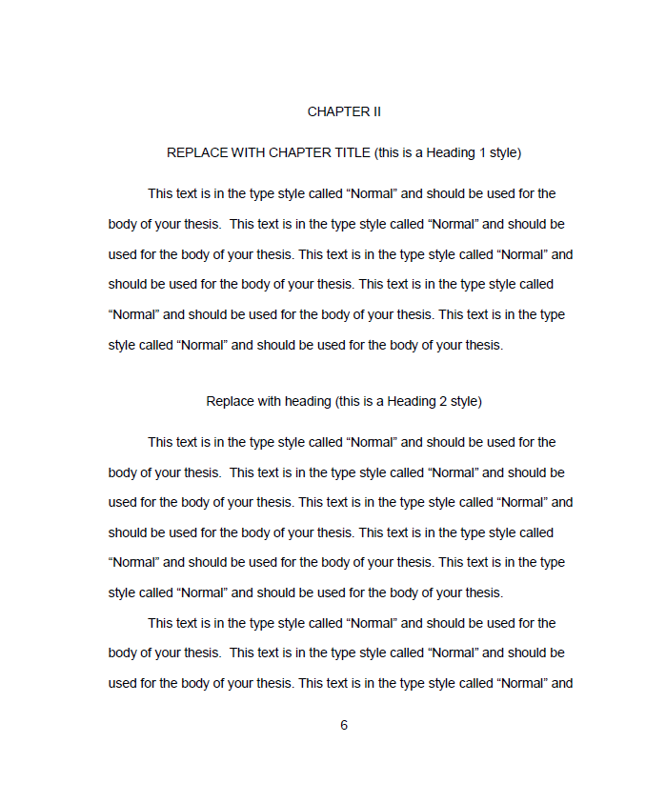
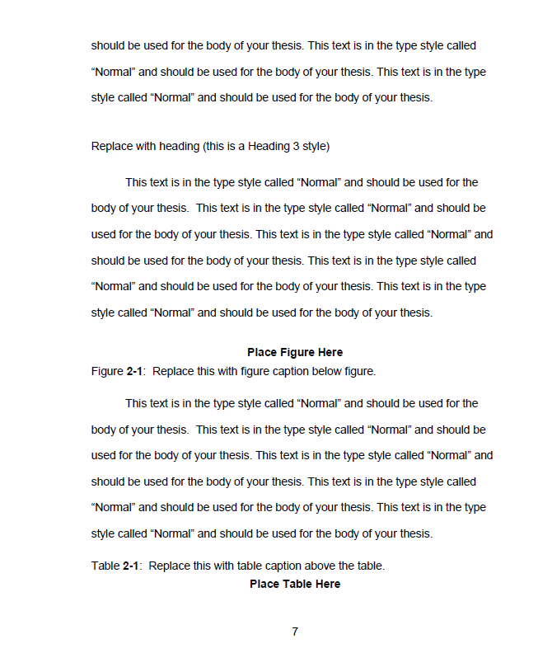
Notes:
Example of proper formatting you can see we start chapter two with a 2 inch top margin you can also see the spacing between the headings and sub level headings notice the minimum of two sentences with each paragraph and sub level
Example of proper formatting You can see we start a chapter with 2” top margin. You can also see the spacing between headings and subheadings.
The bold text is only for emphasis on show a figure or tables being pasted

Slide 31
Chapter Title Pages
A chapter title page is the start of a new chapter.
ALL chapter title pages have a 2” top margin
All chapters start on a new page
CHAPTER I, II, III, etc. are known as chapter headers, a label for your title. Headers are typed in all capital letters without punctuation, centered between the margins
Notes:
Looking specifically at Chapter Title Pages...

Slide 32
Chapter Title Pages (cont’d)
The title appears below the chapter header and is typed in all capital letters, double-spaced below the heading, centered between the margins
  Titles that are more than one line should be double-spaced
Text of the chapter begins three spaces below the chapter title
If a subheading follows a chapter title, it is placed three spaces below the chapter title...text then begins two spaces below the subheading
Notes:
The TITLE of your chapter is to be typed in all capital letters two spaces below the heading, and centered between the margins.
Should the title be more than one line it will be double spaced
The Chapter TEXT will begin three spaces below that chapter title.
-If a chapter begins w/a subheading, the subheading appears three spaces below the chapter title...then two spaces below the subheading title is when the text begins.

Slide 33
Chapter Title Page
Notes:
So this example again is not to scale so much but it shows you how each chapter is formatted correctly: at the start you've noticed the chapter in all capital letters using the upper case Roman numeral
The next line is the chapter TITLE (or heading number 1), all caps as well and centered.
Then notice the difference subheading styles that follow

Slide 34
Bibliography, References or Literature Cited
REFERENCES or BIBLIOGRAPHY should be all capital letters & centered between page margins
2” top margin (first page only)
Page numbering continues in Arabic numerals
Single space within entries with double space between entries
Notes:
appropriate references or bibliography title is in all capital letters and it's centered this is start of a new section so remember use that top 2 inch top margin
page numbering continues with the use of those Arabic numerals
you are to single space within entries and double space between entries
if you're not sure what to use:
your bibliography is gonna refer to all sources that you've read for your research including material not cited;
references that refers to only those sources that are cited in your thesis or dissertation.

Slide 35
Appendices
The material must be set up like a new section
If there is only one appendix
  APPENDIX centered with a 2.0” top margin
  Text/material to follow three spaces below
If there are two or more appendices
  A division page is inserted before APPENDIX A
    The word APPENDICES will be centered between the margins, slightly above the center of the page
    Page number placement continues as in text
    This page will appear in the TOC as well
  Each appendix should be treated as a separate section with its own page
  Labeled APPENDIX A:, APPENDIX B:, etc.
    Be sure to add the individual appendix titles in the TOC .
Notes:
Your appendix or appendices are going to be the last section of your thesis or dissertation and the start of a new section, and we know what that means… the first page requires that 2 inch top margin…
if there's only one appendix, Begin the page with the header APPENDIX in all capital letters, centered just below the two inch top margin. The title comes below this header text, and below that, the text of your appendix
If there are two or more appendices, you will need a division page labled APPENDICES in your manuscript. Each appendix will be treated as a separate section with its own title page. your labels will be appendix a appendix B, and so on, followed by the Appendix title, then text of your appendix

Slide 36

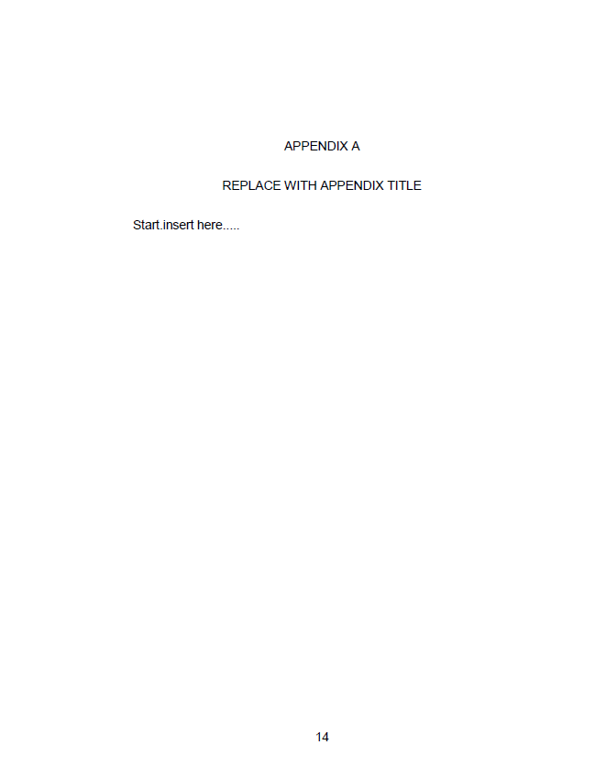
Notes:
Here you can see the introductory appendices page again uses only if you have multiple appendices if you have one appendix, omit the division page

Slide 37

Format Checking
If at any time you have questions, please contact me.
dphillipp@uakron.edu
330-972-2135
Notes:
Almost done. We’re Switching gears now to focus on the format check process, and what happens after you’ve applied the guidelines to your manuscript. I want to remind you that the content of this presentation can be found on the Graduate School website.

Slide 38

Electronic Submission Procedures
      Uploading your ETD to OhioLink
        https://etdadmin.ohiolink.edu
The document you upload to OhioLINK must be your final thesis or dissertation.
This means it has been successfully defended with all committee suggested revisions made.
Notes:
Directions on how to upload your thesis or dissertation to Ohio link can be found on the Graduate School website. It’s pretty straight forward, but I’ll share some slides with you that summarize the submission process. Please note that my format check is done through the OhioLink database, so do NOT submit your manuscripts to my uakron.edu email address.

Slide 39
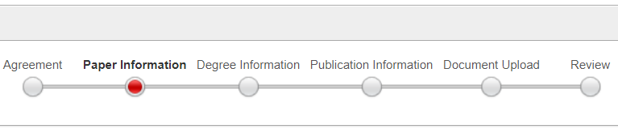
Electronic Submission Procedures
Paper Information Tab
  Last, First, Middle
  Title
  Abstract
  Keywords
  Subject Headings (related disciplines)
  Year Completed
  Pages
Notes:
You'll be asked to provide some basic information about yourself and about your document. OhioLink does require you to provide a brief abstract about your thesis or dissertation, and you can enter key words and subject headings that can later be used to search for your manuscript on OhioLink.

Slide 40

Electronic Submission Procedures
Degree Information Tab
  Degree
  College/School/Dept/Program
  Year
  Committee Members
    Last Name First Name Suffix/Deg Role
Notes:
In the degree information section list all committee members not just your advisor do not enter doctor in the suffix field. You can enter PhD or just leave it blank

Slide 41
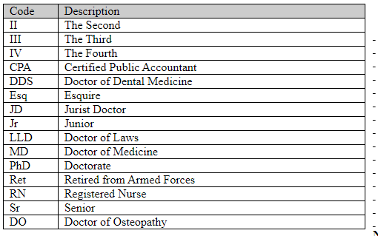
Electronic Submission Procedures
Appropriate Examples of a Suffix
Notes:
List ALL Committee members – not just your advisor
Do not enter Dr. in the Suffix. Dr. is not a suffix. You can enter PhD or leave it blank.

Slide 42
Delay of Publication
  How To: (2 step process)
  Enter the delay of publication information to OhioLink when you upload your manuscript.
  Complete and return the Delay of Publication Form (https://www.uakron.edu/dotAsset/677911.pdf)
  BOTH STEPS ARE REQUIRED: THE GRADUATE SCHOOL IS NOT RESPONSIBLE FOR THE RELEASE OF INFORMATION IF BOTH STEPS ARE NOT FOLLOWED.
Notes:
So in some circumstances you may wish to delay the electronic publication of your thesis or dissertation. This is a two step process
-first you enter the delay of publication information in ohiolink when uploading your manuscript. As the author, you can only request a 1-2yr delay, but as an administrator, I can extend your request up to 5 years... That’s where the Request to Delay Publication comes into play. The request form is available on the Graduate School website... On it, you will enter the date you wish to have your manuscript released.

Slide 43

Electronic Submission Procedures
Publication Information Tab
  Copyright
  Delay of Publication
  Reviewer Action (Graduate School can only access this)
  Proquest/UMI
  Enter the delay of publication information to OhioLink when you upload your manuscript.
  Complete and return the Delay of Publication Form (https://www.uakron.edu/dotAsset/677911.pdf
  BOTH STEPS ARE REQUIRED: THE GRADUATE SCHOOL IS NOT RESPONSIBLE FOR THE RELEASE OF INFORMATION IF BOTH
  STEPS ARE NOT FOLLOWED.
Notes:
So in some circumstances you may wish to delay the electronic publication of your thesis or dissertation. This is a two step process
-first you enter the delay of publication information in ohiolink when uploading your manuscript. As the author, you can only request a 1-2yr delay, but as an administrator, I can extend your request up to 5 years... That’s where the Request to Delay Publication comes into play. The request form is available on the Graduate School website... On it, you will enter the date you wish to have your manuscript released.

Slide 44
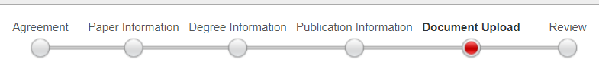
Electronic Submission Procedures
Document Upload Tab
  Document Type
  File
Notes:
Your manuscript must be in pdf form.
You may upload supplemental documents (e.g., video) – Rarely used, but available.

Slide 45
Format Checking and OhioLINK
Please note your manuscript will not be visible to the public when you upload it to OhioLink. It will only be visible to me.
Your manuscript will be released for public view after your degree has been conferred by the University Registrar. Exception: When a delay of publication has been submitted
Notes:
Your manuscript will not be visible to the public when you initially upload it to ohiolink. it will only be visible to me and I will perform the format check review. I’ll then email you the results of your format check.
If your manuscript is returned, you will also receive a notice from Ohio link. Please play close attention to those notes I sent back to you because those are going to outline any formatting issues that need to be addressed.
Your thesis or dissertation will be released for public view after your degree has been conferred by the university registrar. The only exception is if you've submitted delay of publication request.

Slide 46

DIGITAL ACCESSIBILTY
Minimum Digital Accessibility Standards
(MDAS)
Notes:
In addition to the University of Akron’s formatting guidelines for publication, OhioLink now requires thesis or dissertation submissions to meet what are known as Digital Accessibility Standards (MDAS) prior to publishing. Compliance ensures that published manuscripts can be viewed on a variety of technology (laptop, mobile phone, personal data assistants, etc.), and be accessed by readers who may have a disability requiring use of a screen reader.

Slide 47
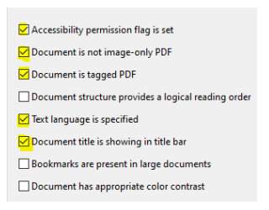
DIGITAL ACCESSIBILTY
Notes:
The Graduate School has provided you with information on its website that will aid you in complying with these requirements established by the State of Ohio... For example... What are the five minimum accessibility standards that must be met..?

Slide 48

DIGITAL ACCESSIBILTY
Notes:
Adobe Acrobat Pro is required software as it includes all the tools needed to successfully complete the accessibility check. The Grad school website provides guidance on different ways to access this software.

Slide 49
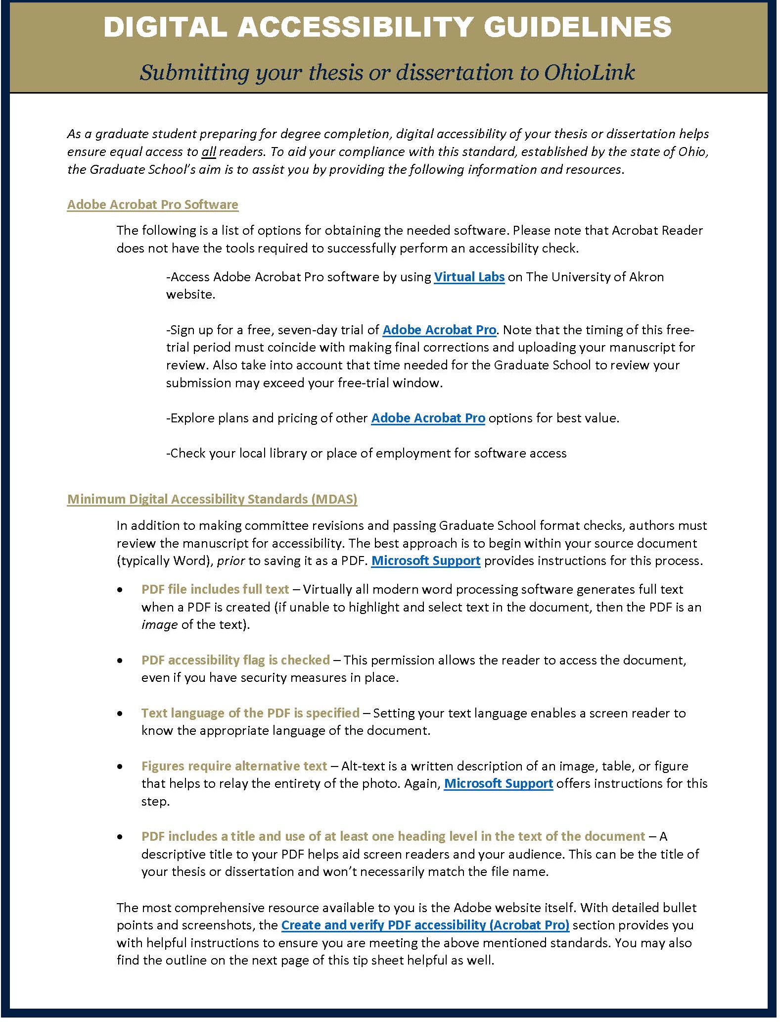
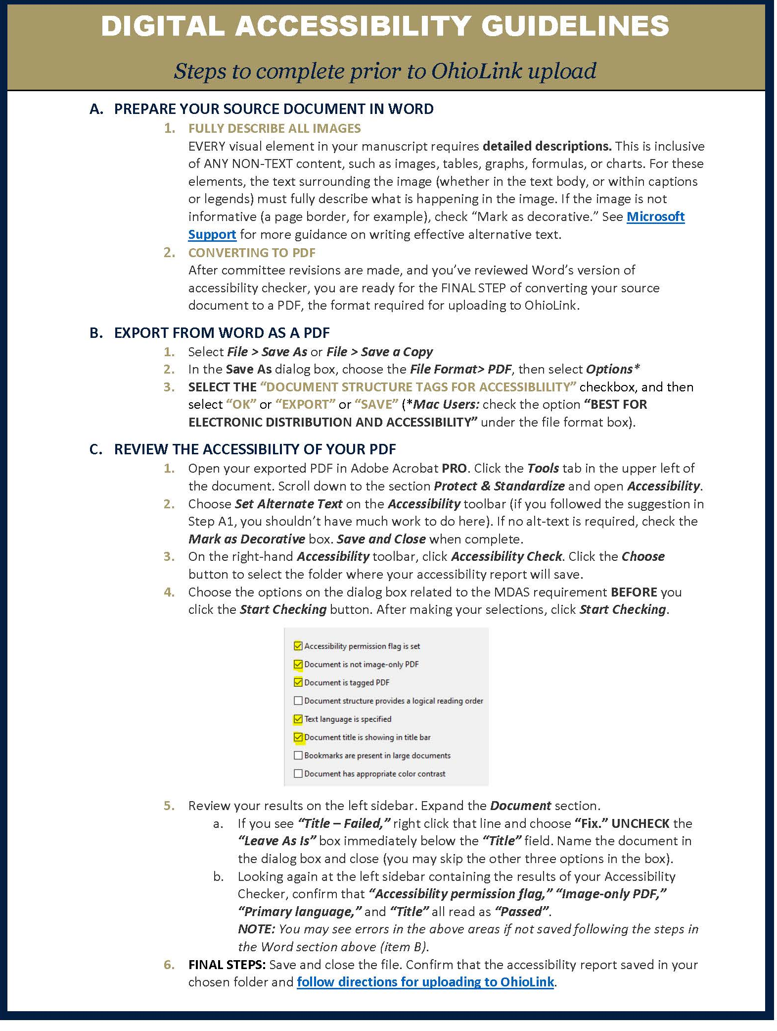
DIGITAL ACCESSIBILTY
Notes:
Take the time to read the overview and step-by-step instructions you see here on this slide... The link to which can be found on the grad school website. It is your responsibility to apply these accessibility standards to your document and in doing so, it may be necessary to explore the technical sites referenced in the document you see here.
Please note that failed digital accessibility checks could negatively impact your eligibility to graduate.
The dissertation milestone on your degree audit will not be cleared until both the formatting AND the digital accessibility checks have cleared.

Slide 50

Important Dates
Notes:
I would like to stress to you the importance of planning ahead when you are preparing a thesis or dissertation. the most current deadlines are always posted on the Graduate School website. Work closely with your advisor to schedule that defense so you can graduate on time.
Your advisor and your committee members all have busy schedules so once you have your defense schedule you can work and plan backwards from that date don't wait till that last minute and then try to scramble to grab that date which might not be available. If you fail to meet the deadline your graduation may be deferred to the next term.

Slide 51
Questions and Contact Information
Deborah A. Phillipp, M.Ed.
Director, Graduate School & Student Services
Simmons Hall – Suite 205
dphillipp@uakron.edu
330-972-2135
Notes:
I hope you found this presentation helpful. Please contact me if you have any questions about the format check process.
Thank you and Good luck.

